Slide 1
Project :InterStellar

Slide 2
Problem Statement
Current Inter-Bank settlement process requires complete involvement of Bangladesh Bank
Upon cheque submission, every bank is bound to scan and create a digital copy > send it to Bangladesh Bank’s server > after central bank’s verification, they can settle the claim.
There is no peer-to-peer transaction system for the commercial banks of Bangladesh
We need a secured system that will help peer-to-peer Inter-Bank Settlement for the Banks of Bangladesh.

Slide 3
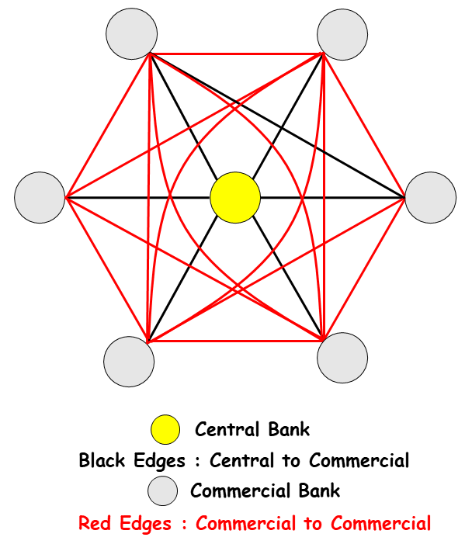
Proposed Solution
A blockchain backed inter-bank settlement system that will help the banks to discharges the irrevocable and unconditional obligation of the payer bank to the payee bank in respect of money transfer.

Slide 4
System Workflow
Registration and Participation
A commercial banks have to deposit a certain amount of money in the deposit of Central Bank
Central Bank grants permission of participation for the commercial bank
This participation permission is granted with a time limit subjected to extension further
Settle Token Issuance
The Central Bank issues settle token, backed by the amount each bank has deposited
This settle-tokens are stable coins and their values are tagged with the value of BDT
Claims and Settlements
BankB is bound to pay the amount within that working day by using Settle-Token as a payment method
BankA can convert the Settle token to fiat currency
If not paid by the predefined time frame ,BankB will be charged 5% extra for each additional day
Customer Claim
When the customers submit a cheque on one bank (BankA) with another bank's name(BankB) on it, BankA checks the validity of cheque by contacting BankB
Valid cheque's request is honored by BankA
With the amount being paid by BankB, claim is issued on Bank A

Slide 5
Implementation

Slide 6

Blockchain Type: Permissioned Private (R3 Corda)
Platform to use system's existing
Peer to Peer Private Communication , Distributed Ledger and 6300 TPS
Why Corda?
Peer to peer private ledger
Sharding to handle increasing throughput

Slide 7
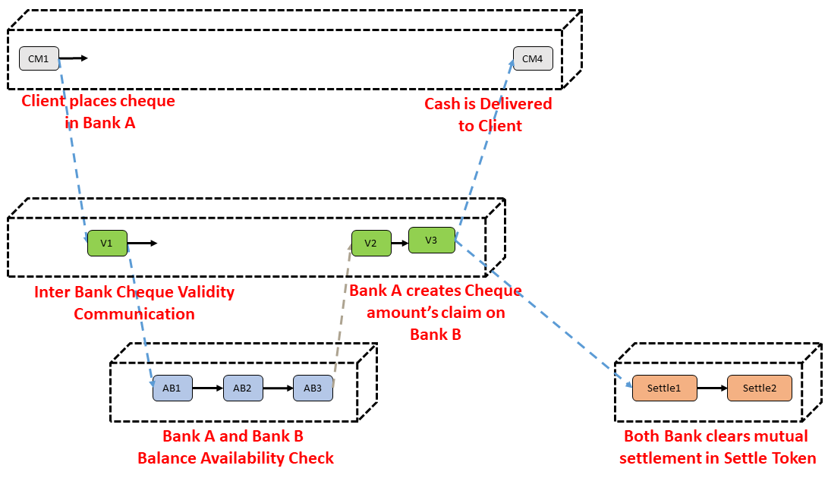
Representation of States in r3 Corda

Slide 8


System Module’s Overview
There are 3 main functional module that are mandatory for working
Token Issuance only by Central Bank
Request handling
of Valid Cheque
Token Transfer between Commercial Banks
Project Link : https://github.com/arafMustavi/Inter-Stellar

Slide 9
Governance
Bangladesh Bank
Privacy
Security
States and Vaults
r3 corda’s Key Management
And Hashing Protocol
Competition
Partners
Taboo in Cryptography Management’s Unwillingness
Existing Modules
Commercial Banks
Risk
Cheque Validation Bottleneck

Slide 10
Future Prospect and Market

Slide 11
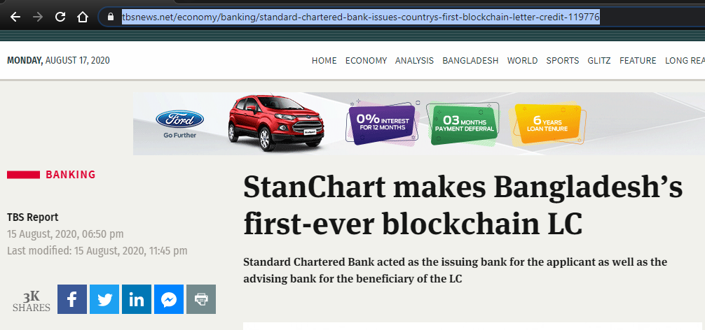
Link to the News

Slide 12
Prototype

Slide 13
Module 01

Slide 14
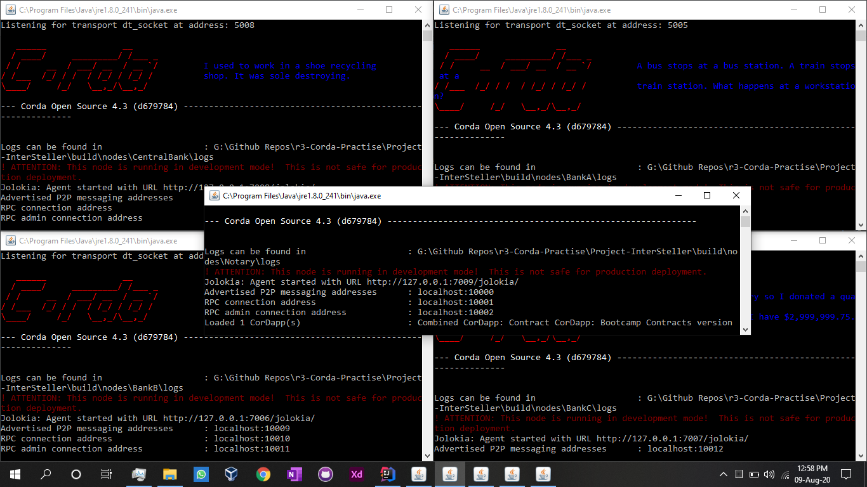
Banks and Notary
Central Bank
BankA
Notary
BankB
BankC

Slide 15
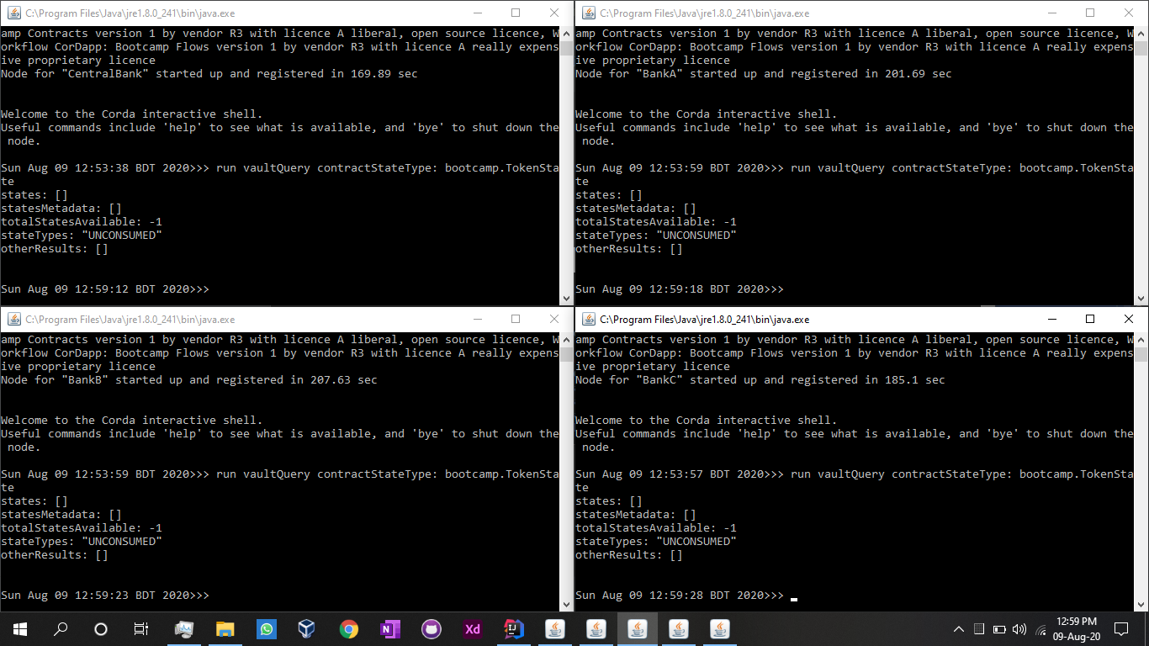
Initial Vault States after Vault Query
Central Bank
BankA
BankB
BankC

Slide 16
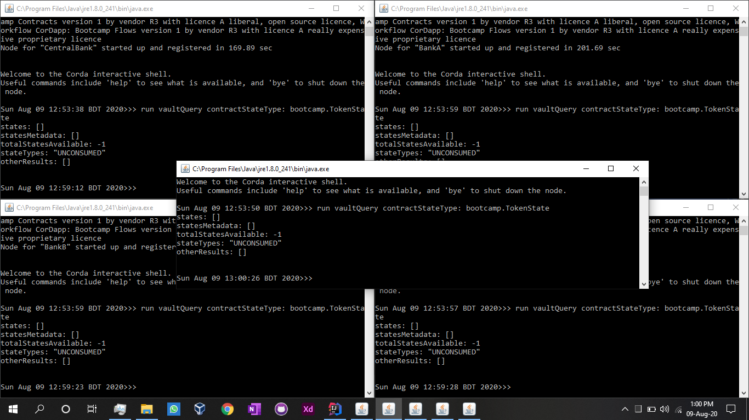
Initial States are Empty
Central Bank
BankA
Notary
BankB
BankC

Slide 17
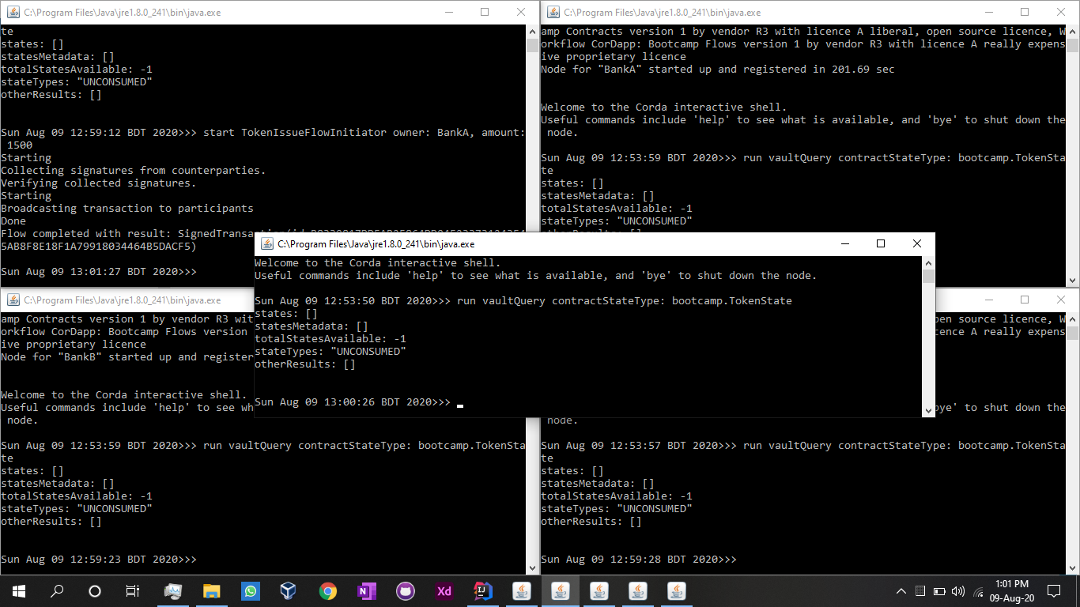
Central Bank
Token Issue for BankA
BankA
Notary
BankB
BankC

Slide 18
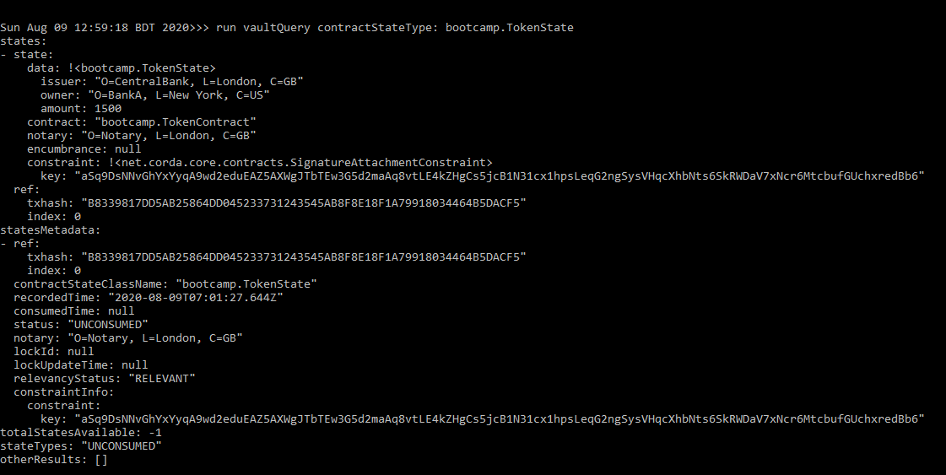
Vault Query after Token Issue for BankA
BankB couldn’t Issue Tokens

Slide 19
Failure Analysis on other modules
Syncing nodes are generating failed task error in my machine. But Corda has this support to pass and verify data by Inter-Node Data Communication. Corda supports attaching databases with every node and we can store + retrieve data from those nodes. Though I couldn’t implement this but its implementable.
Sub flow in IOU token flow is issuing errors. But corda do provide supports for token transfers between nodes by its implemented Tokens SDK. So its implementable.

Slide 20


Thank You!
Feel free to reach out at
arafmustavi@gmail.com
/arafmustavi

